Slide 1


Title
xxxxxxxxxxxxxx
xxxxxx

Slide 2
AGENDA
POINT 1
POINT 2
POINT 3
POINT 4
POINT 5
POINT 6

Slide 3

TITLE SLIDE 1

Slide 4
TITLE SLIDE 2

Slide 5


How well do you know the
Play Their Way movement?
Activity: Rate your knowledge of Play Their Way and child-first coaching
1 2 3 4 5 6 7 8 9 10
Never heard of it!
I know all about it.
Just call me an expert.
Notes:
ACTIVITY: get to know the knowledge base of the room with this quick exercise. You’ll be able to judge how much detail you need to go into for the Play Their Way recap slides.

Slide 6
Play Their Way
Where it all began…

Slide 7

45%
Only 50% of young people
Who take part in sport and physical activity say they really enjoy it!
Sport England, Active Lives 2019-20
Notes:
Presenter notes – It was this stat from the Sport England Active Lives survey that was a catalyst for the Play Their Way movement. It sparked questions like, ‘why do only 45% of CYP enjoy exercise?’, ‘What can we do about the other 55%?!’ ‘Why do 55% of CYP not enjoy taking part in sport and activity?’

Slide 8
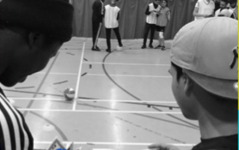
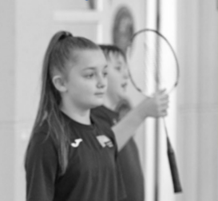

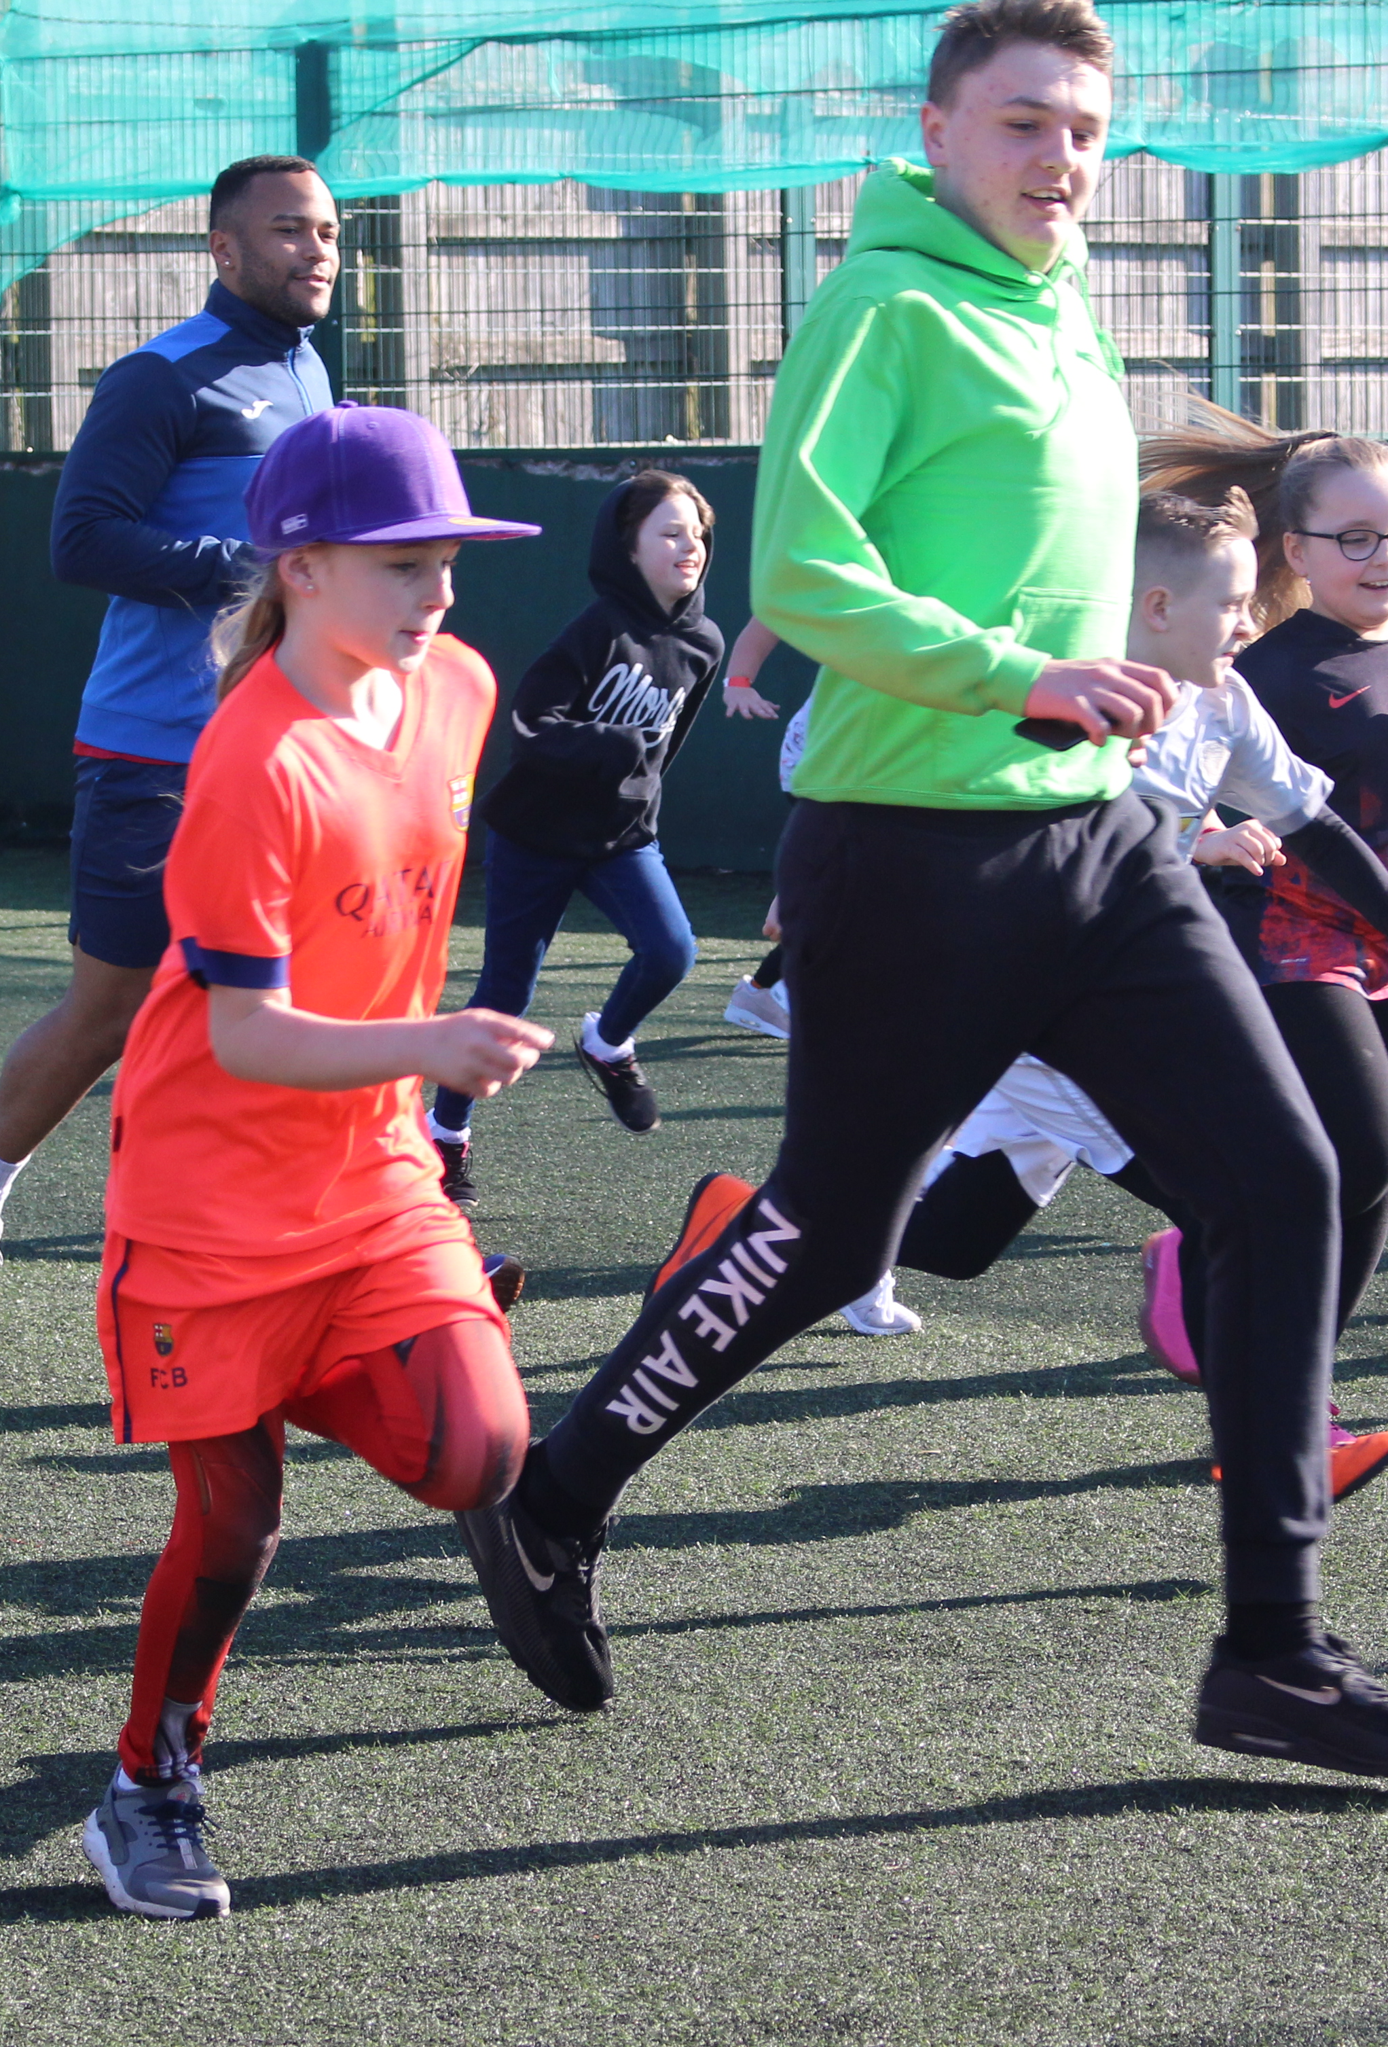

Body image
Low confidence
No enjoyment
Pushy coaches and parents
Peer pressure /social media
Fear of failure
Bullying
Too much focus on winning
Inaccessibility
Notes:
Presenter notes – These are some of the reasons why CYP don’t enjoy taking part in sport and physical activity. The aim of the Play Their Way movement is to make sport and physical activity enjoyable for all children and young people so they develop a lifelong love for being active.

Slide 9
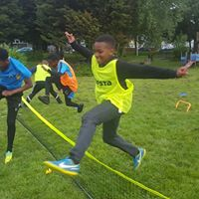
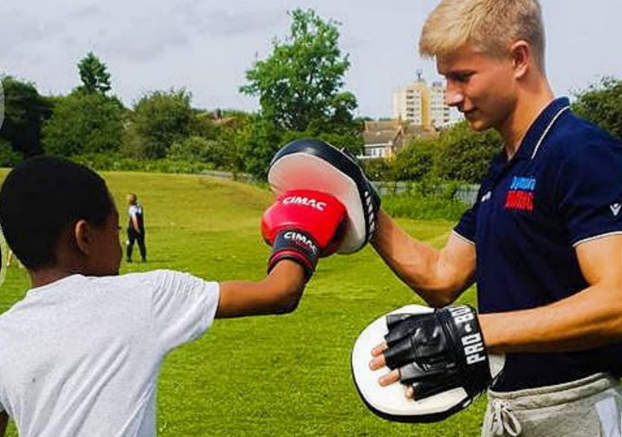
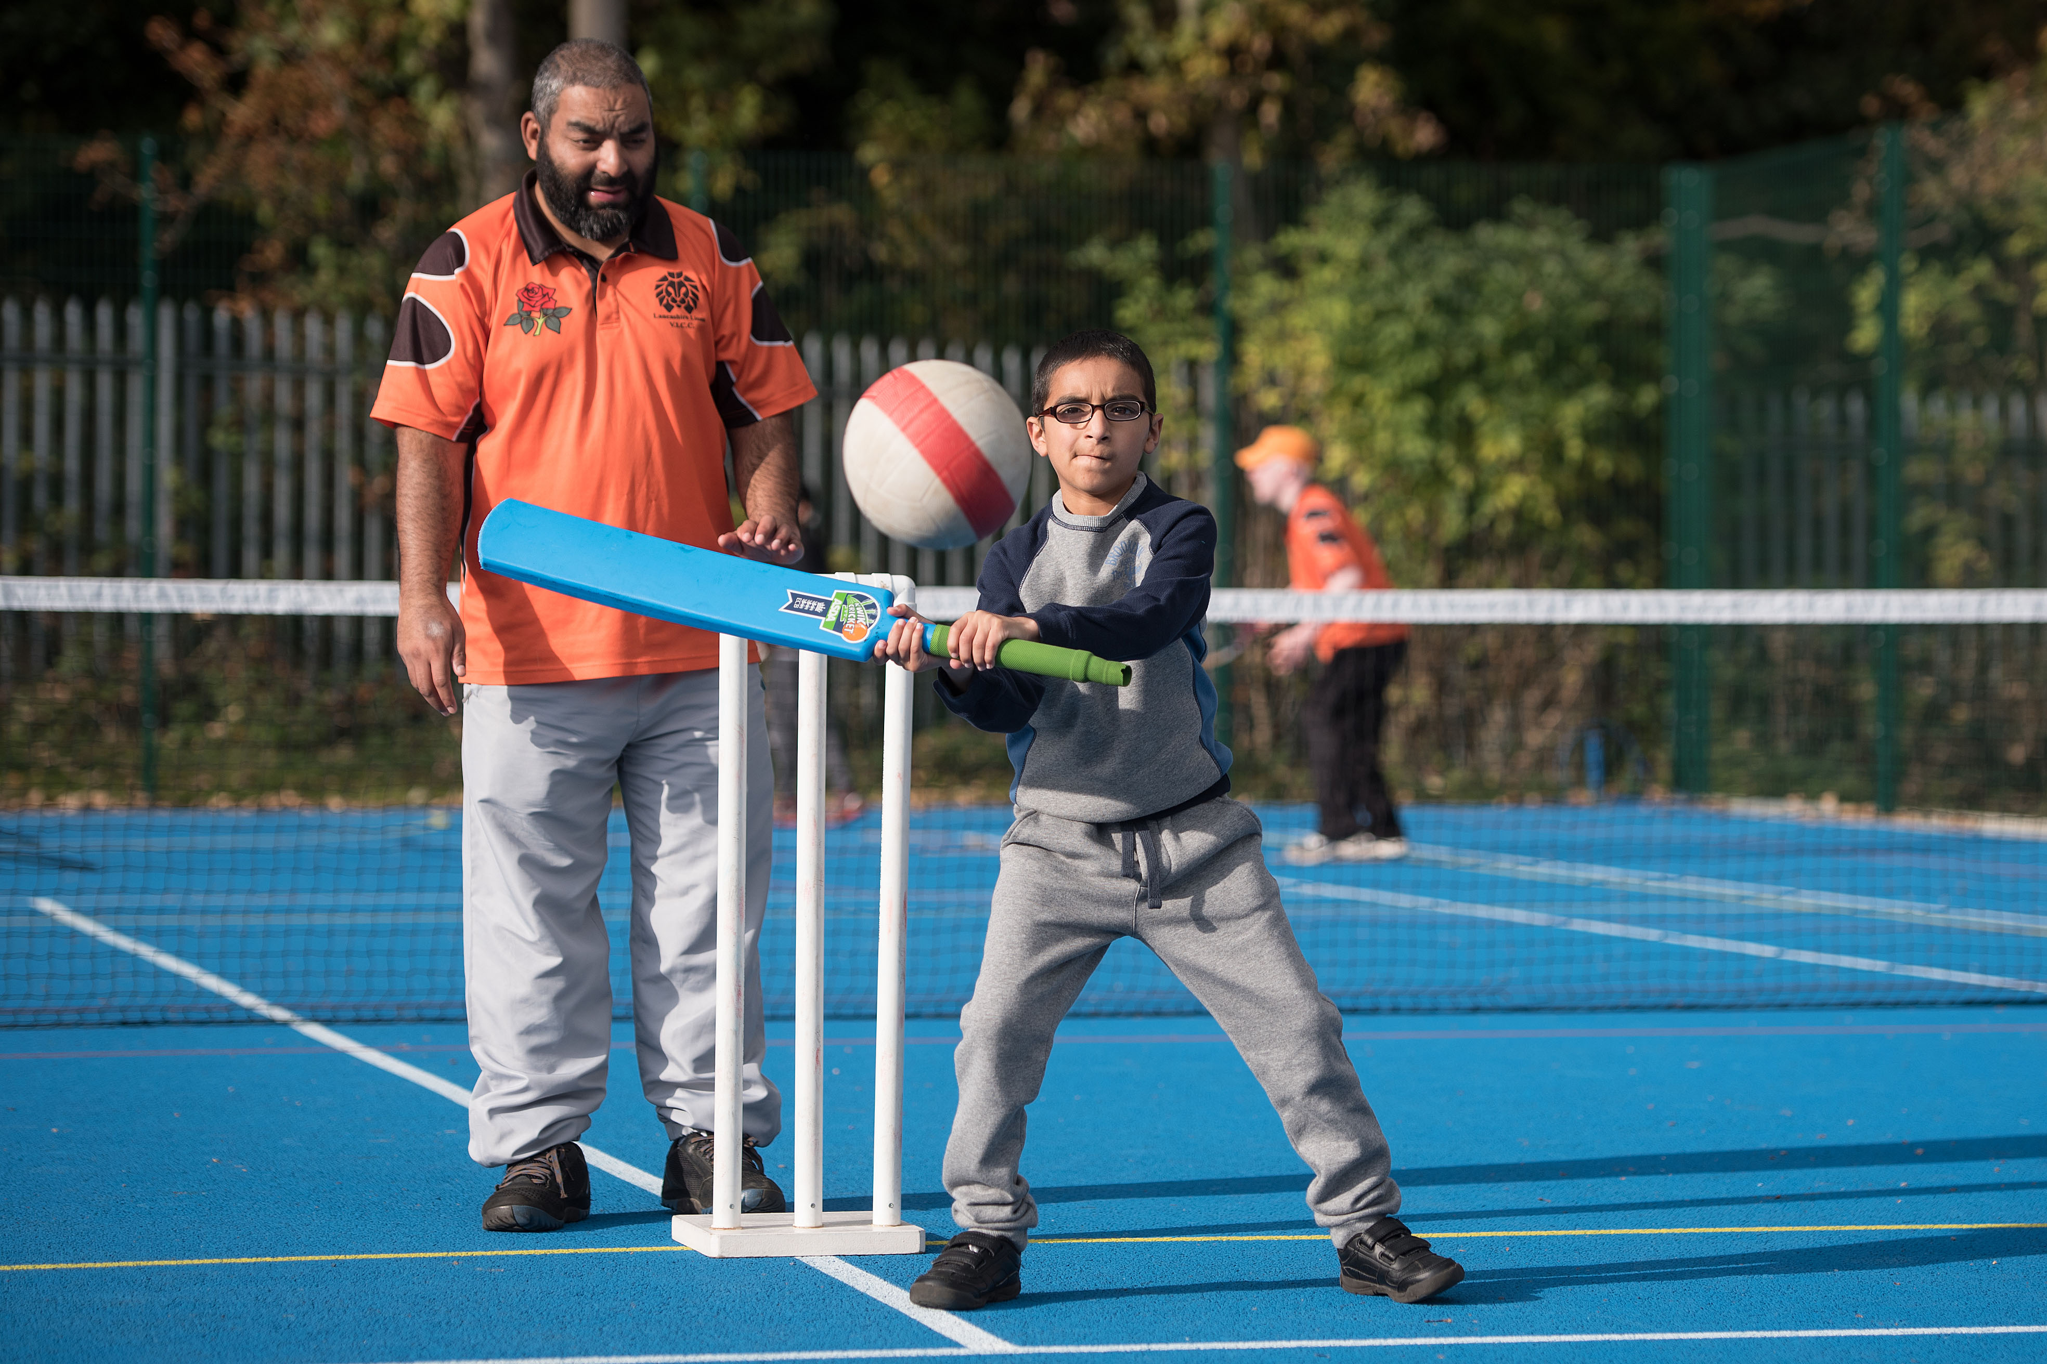
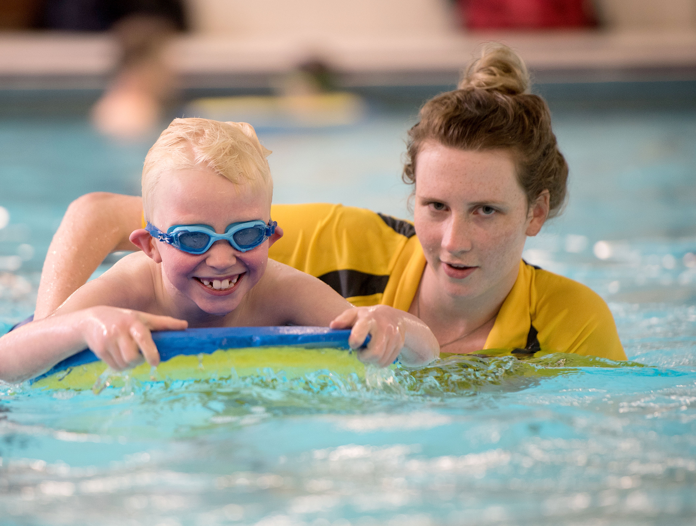
Coaching is Key
The coach is the most important factor in determining whether a session is perceived as ‘good’.
Nearly a quarter (22%) of coaches felt they were at risk of dropping out in the future.
2022 Leeds Beckett University Research
45% or 3.8 million young people aged 7-17 participate in activities outside of school which a coach leads.
2019 UK Coaching Survey
Notes:
Presenter notes – How do we get more CYP active and enjoying it? Coaching is key. That’s why the Play Their Way movement is about supporting coaches adopt child-first coaching principles. What are child-first coaching principles?

Slide 10
Play Their Way
What is it all about?

Slide 11
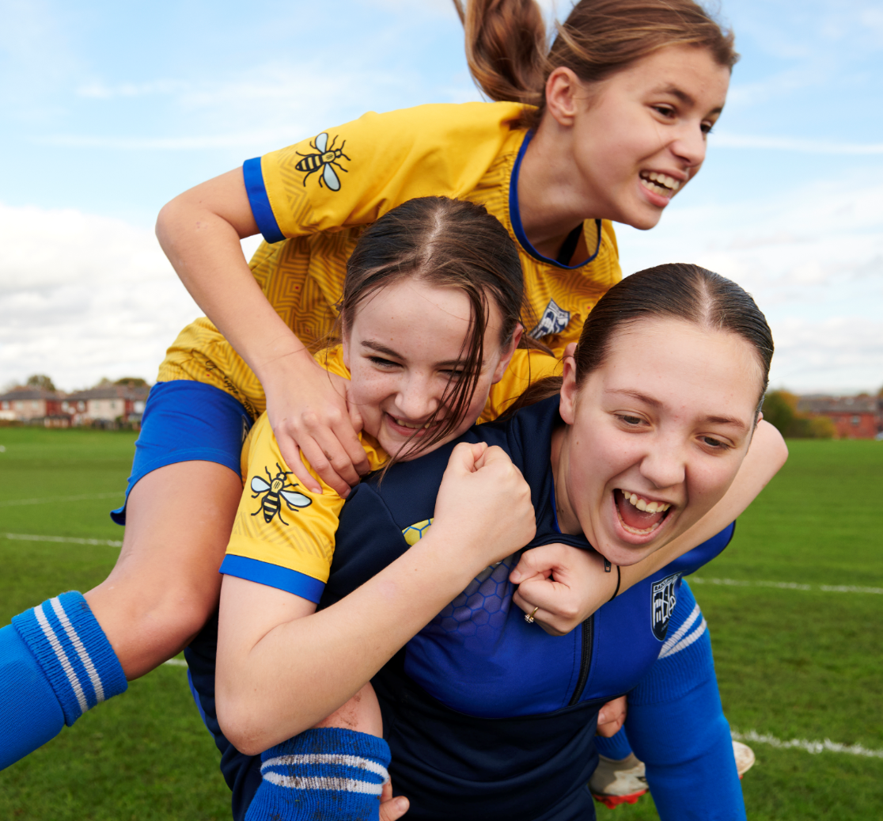
The Play Their Way movement is made up of coaches, organisations and people who are passionate about child-first coaching.
The child-first coaching philosophy has a grounding in children’s rights as outlined in the UN Convention on the Rights of the Child; the right to be heard, the right to play and the right to develop.

Slide 12
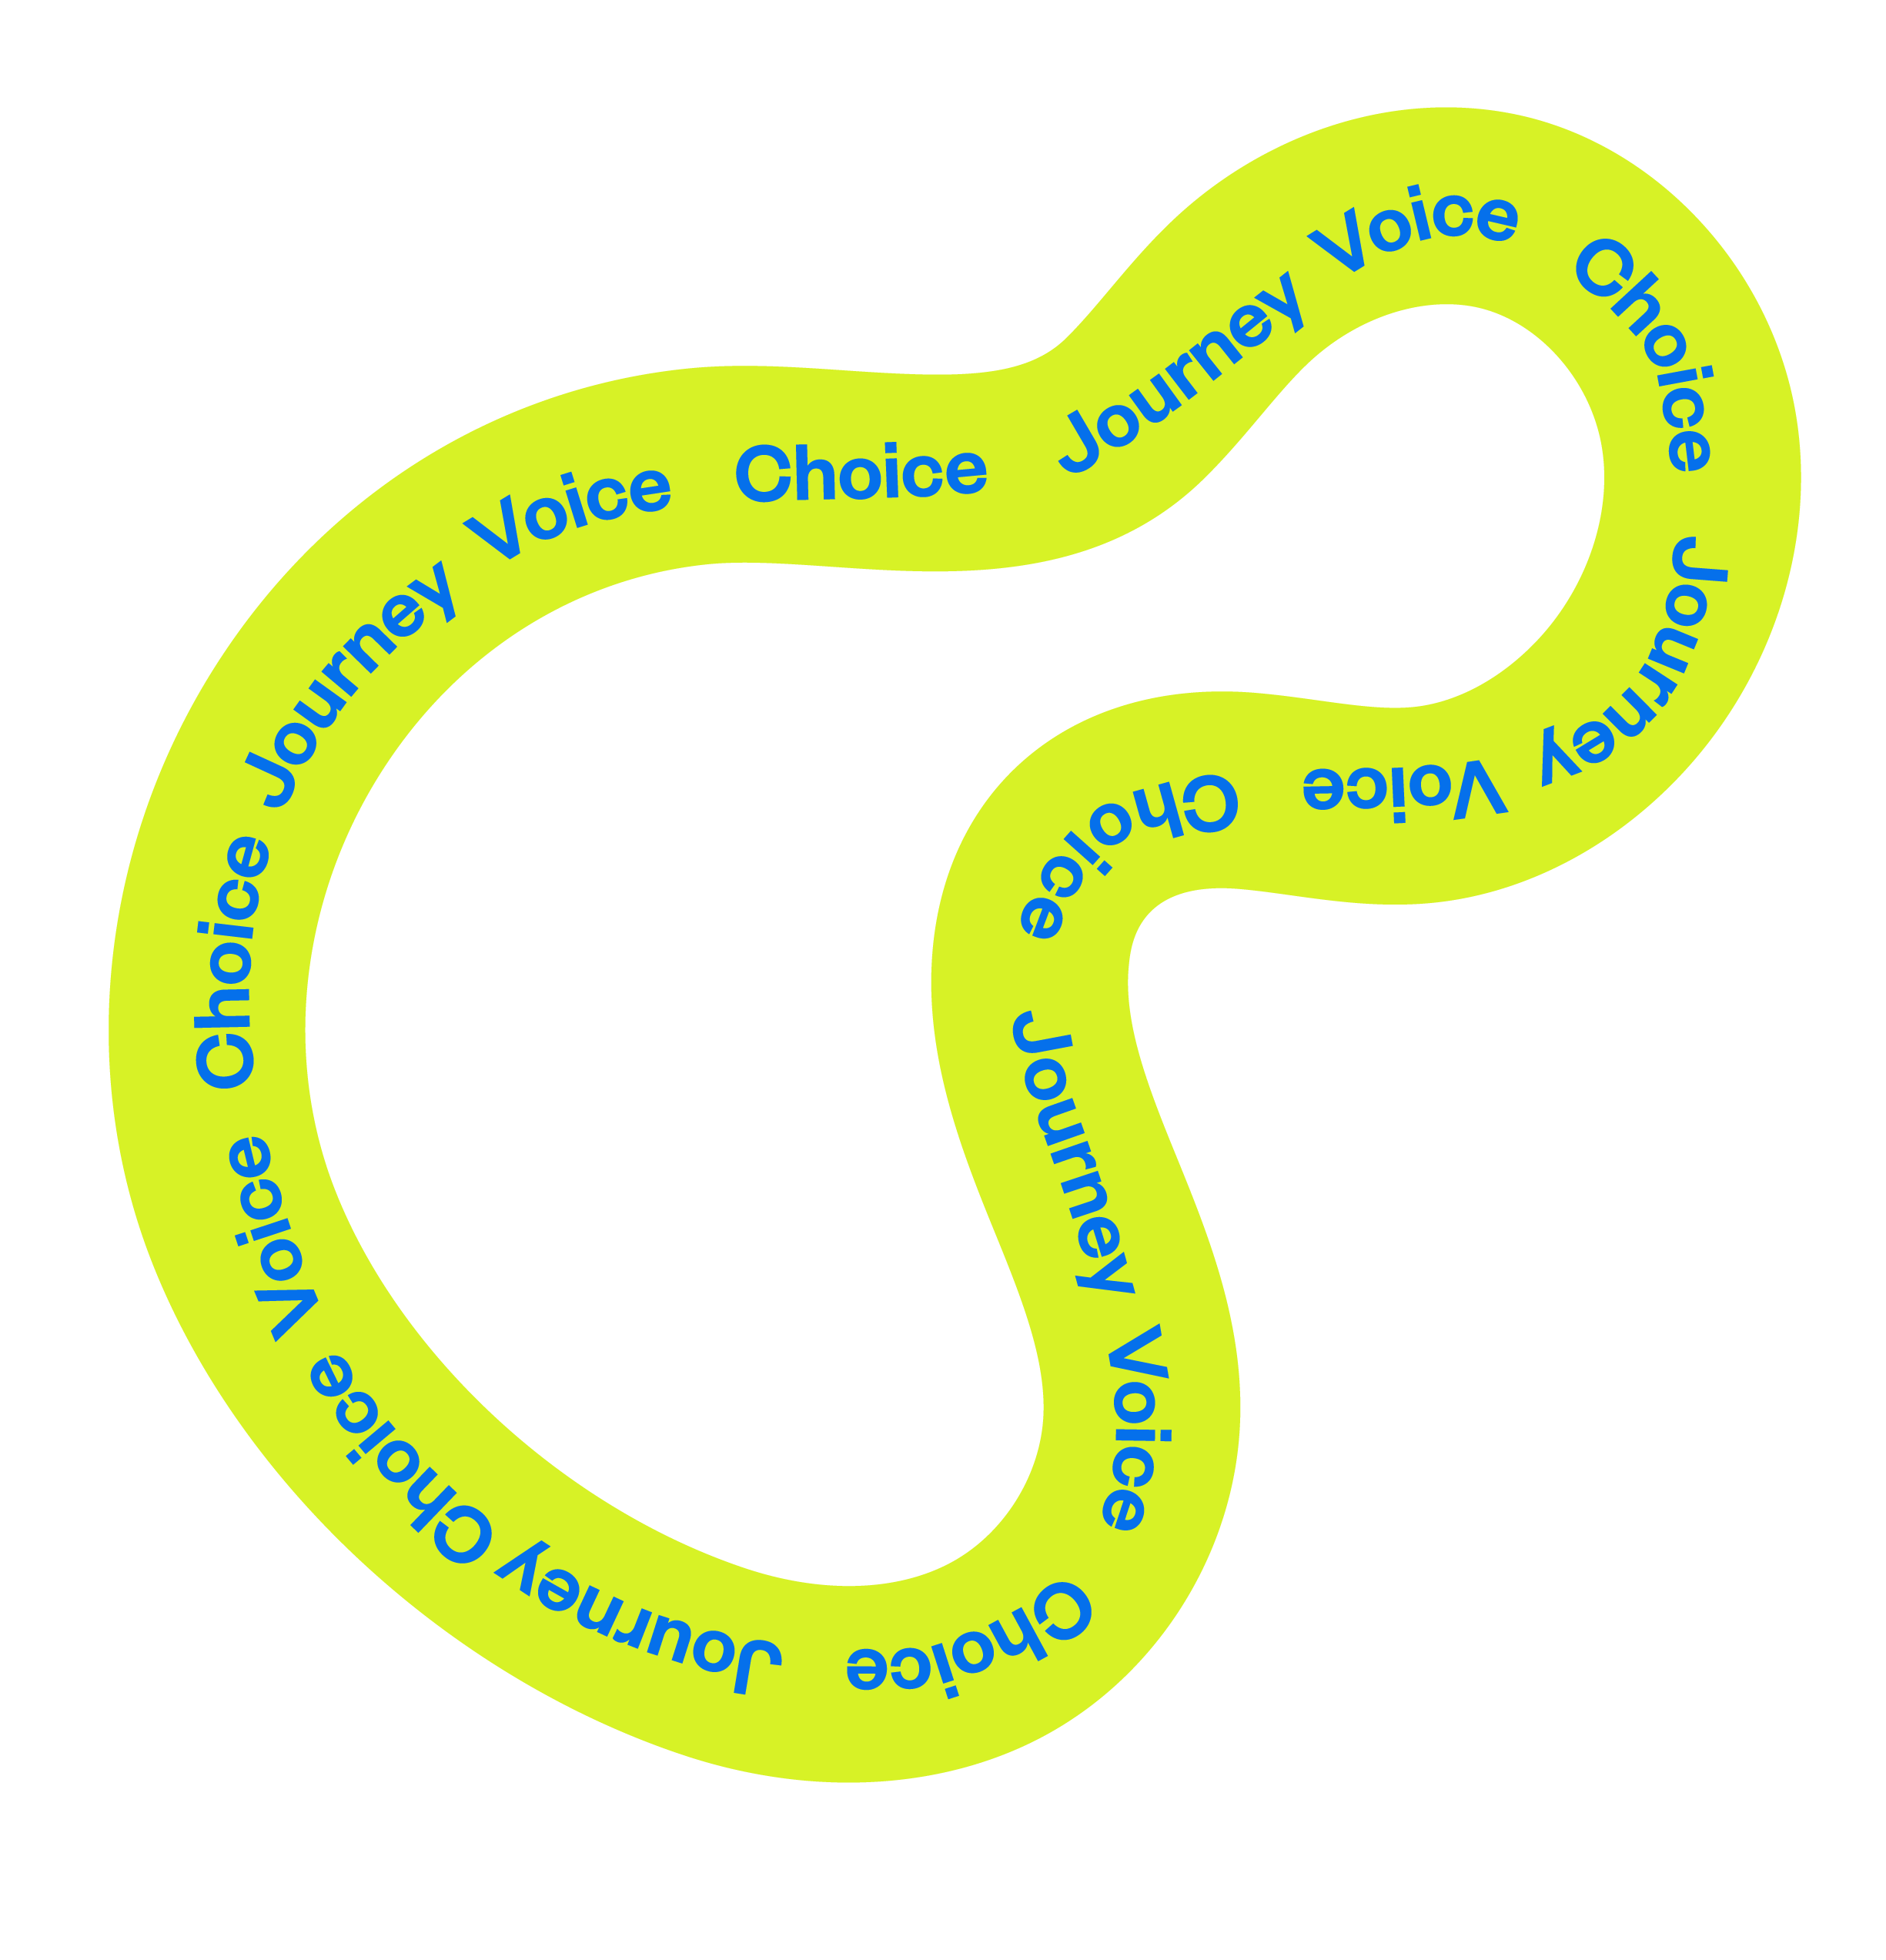

Child-first Coaching
There are three key ingredients of this approach which reflect the rights of children and young people to be heard, to play and to develop:
Voice: Children and young people have the right to express their views, which are acted on together in a meaningful way.
Choice: Children and young people shape have the right to play and shape what play looks like.
Journey: Children and young people have the right to develop holistically, in their own way.
Notes:
The child-first coaching movement is centred around the three pillars, they are voice, choice and journey. At the very heart of each pillar is a children’s right. Voice is about the child’s right to be heard. Choice is the child’s right to play and journey is the child’s right to develop in their own way.

Slide 13


1. What does child-first coaching mean to you?
2. What games and activities did you like playing as a child? What were the rules?
3. Why do you coach?
4. What did your coaches do that you enjoyed as a child?
Notes:
Activity: Warm up – using questions that promote thinking about using peoples’ lived experience to start to frame their thinking
#1. Discuss in pairs / small groups – all questions / as many as they want to
#2. Four groups discuss one question each – then feedback / share with another group
#3. Choose one question you want to discuss (based on group) *Use the following slides*

Slide 14
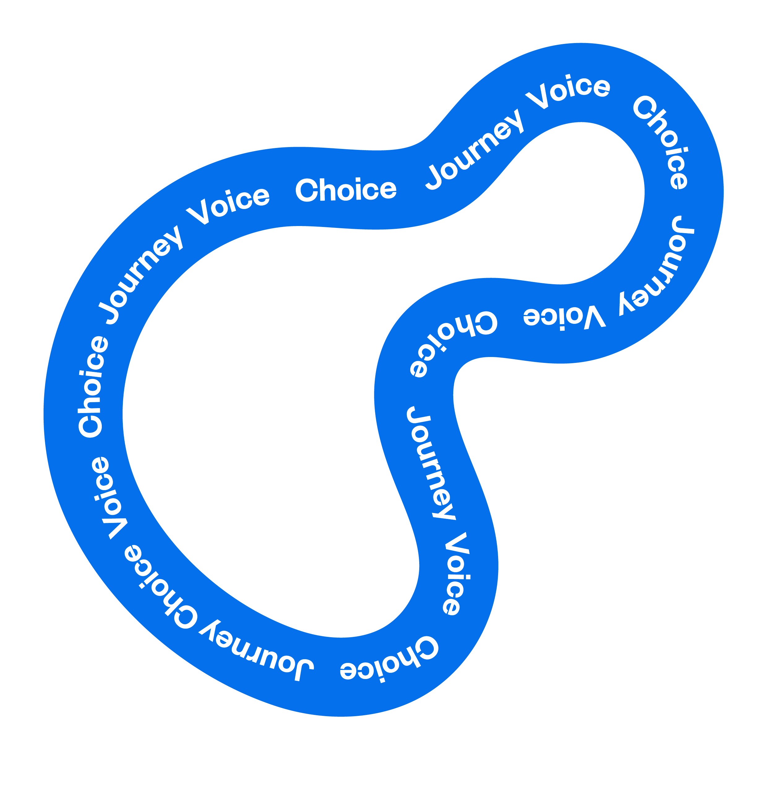
What does child-first coaching mean to you?

Slide 15
What games and activities did you like playing as a child?
What were the rules?

Slide 16
Why do you coach?

Slide 17
What did your coaches do that you enjoyed as a child?

Slide 18
The Three Pillars of Child-first Coaching
A deep dive into Voice, Choice and Journey

Slide 19
Child-first Coaching Framework
Voice
Choice
Journey
The Right To
Be Heard
The Right To Play
The Right
To Develop
Notes:
This framework unpacks what we mean by Voice, Choice and Journey – linked to children’s rights

Slide 20
Child-first Coaching Framework
Voice
Choice
Journey
The Right To
Be Heard
The Right To Play
The Right
To Develop
Listening:
Encouraging participation and actively listening to a child’s wishes.
Inclusivity:
Ensuring every child is given the opportunity to input and shape their experience.
Creativity:
Encourage their imagination and welcome creative input from children.
Co-Creation:
Enable play that is self-directed and facilitate spontaneity and freedom.
Individual:
Having an approach tailored to the needs and abilities of each child – ensuring everyone is included.
Holistic:
Support the physical and mental development of the child depending on their best outcomes.
Notes:
Examples of what we mean by voice, choice & journey

Slide 21
What’s the child-first coaching pillar?
Notes:
Activity: This activity can be used to check knowledge of voice, choice & journey
*can use the pdf to do the activity if you prefer*
#1. use at this start point to check people’s current understanding
#2. use as a recap at the end of this section following an intro to VCJ

Slide 22



What’s the Child-first Coaching pillar?
1. “At the beginning of every session I make a point of finding out how each child’s week has been so far. I ask the question in a group setting as well as asking the quieter children individually. This not only helps me get to know the children better, it also helps me to gauge the mood and energy levels of the group”
Sarah, Hockey Coach
Notes:
Activity: This activity can be used to check knowledge of voice, choice & journey
*can use the pdf to do the activity if you prefer*
#1. use at this start point to check people’s current understanding
#2. use as a recap at the end of this section following an intro to VCJ
ANSWER: 1. Voice

Slide 23
What’s the Child-first Coaching pillar?
2. “Every Thursday I coach a group of children athletics. Although athletics is an individual sport I think it’s important that the children get to know each other and play together. At the end of every session I ask the children to choose a game to end on. It doesn’t have to be related to the sport, just a game they want to play together.”
John, Athletics Coach
Notes:
Activity: This activity can be used to check knowledge of voice, choice & journey
*can use the pdf to do the activity if you prefer*
#1. use at this start point to check people’s current understanding
#2. use as a recap at the end of this section following an intro to VCJ
ANSWER: 2. Choice

Slide 24
What’s the Child-first Coaching pillar?
3. “What I find difficult is ensuring all the young players get what they want out of the sessions. I’ve started setting up three activities which focus on different skills and I ask the players to choose which one they want to do based on what they want to focus on in the session.”
Manish, Football Coach
Notes:
Activity: This activity can be used to check knowledge of voice, choice & journey
*can use the pdf to do the activity if you prefer*
#1. use at this start point to check people’s current understanding
#2. use as a recap at the end of this section following an intro to VCJ
ANSWER: 3. Journey

Slide 25
What’s the Child-first Coaching pillar?
4. “This year I am coaching a quiet group of young people which I am not used to! In the past I’ve been able to directly ask the group what they liked and what they didn’t. This time it’s different. I’ve started printing off emoji’s and cutting them out. I write the activity on the board and as the young people leave they choose an emoji and stick it under the activity.”
Nadia, Dance Coach
Notes:
Activity: This activity can be used to check knowledge of voice, choice & journey
*can use the pdf to do the activity if you prefer*
#1. use at this start point to check people’s current understanding
#2. use as a recap at the end of this section following an intro to VCJ
ANSWER: 4. Voice

Slide 26
What’s the Child-first Coaching pillar?
5. “The children and I have created a pack of activity cards based on the games they have created together which focuses on a different skill. The children choose games from the pack and we play one at the beginning and the other at the end.”
Maria, Rugby Coach
Notes:
Activity: This activity can be used to check knowledge of voice, choice & journey
*can use the pdf to do the activity if you prefer*
#1. use at this start point to check people’s current understanding
#2. use as a recap at the end of this section following an intro to VCJ
ANSWER: 5. Choice

Slide 27
What’s the Child-first Coaching pillar?
6. “I used to think it was one size fits all and that everyone should be following the same programme and achieve the same goal. I quickly realised that just doesn’t work. Now, when I start a new coaching programme I ask each child what they want to get out of it and I make sure that the activities we do within the sessions help the children achieve their goals. At the end of the programme we always celebrate everyone’s individual achievements. I think that’s important because it builds confidence.”
Kaleb, Canoeing Coach
Notes:
Activity: This activity can be used to check knowledge of voice, choice & journey
*can use the pdf to do the activity if you prefer*
#1. use at this start point to check people’s current understanding
#2. use as a recap at the end of this section following an intro to VCJ
ANSWER: 6. Journey

Slide 28

Child-first Coaching Framework
Voice
The Right To
Be Heard
Listening:
Encouraging participation and actively listening to a child’s wishes.
Inclusivity:
Ensuring every child is given the opportunity to input and shape their experience.
Children and young people have space to share their views, which are acted on together in a meaningful way.
Notes:
Examples of what we mean by voice

Slide 29
Children and young people have space to share their views, which are acted on together in a meaningful way.
Activity: Consider the questions regarding VOICE
Do you have an agreed way to let the children ‘check in’ at the start of the practice
How do you create a range of different opportunities for the children and young people at your practice to share their views?
What is the most effective strategy you use to encourage children and young people in practice to share what they think
Notes:
Activity: For a group of coaches who have some experience of child-first coaching – you can use the questions to gather their experiences / ideas of how to incorporate voice into coaching practice
Think about / discuss the questions
#1. Discuss in pairs / small groups – all questions / as many as they want to
#2. Three groups discuss one question each – then feedback / share with another group
#3. Coaches can self-reflect on the questions regarding their own practice
*examples of how to incorporate voice are given on the next slide

Slide 30
Voice: Children and young people (CYP) have space to share their views, which are acted on together in a meaningful way.
At the beginning of the session find out how the CYP are and how their week has been.
This small step helps to create an environment where CYP feel confident to express themselves.
Ask for feedback on activities and find out what the CYP want to do in the next session. This will help you shape the sessions so they are not only beneficial for the CYP you are coaching but more enjoyable as well.
Be creative in the way you get feedback from CYP. Emoji cards or thumbs up, thumbs down are a good way to gather feedback from a group of young or quiet children. This may help a new group of CYP build confidence in giving feedback.
Notes:
Examples of how you can incorporate Voice into coaching
*You can replace these examples with ones relevant to your sport/activity*

Slide 31

Child-first Coaching Framework
Choice
The Right To Play
Creativity:
Encourage their imagination and welcome creative input from children.
Co-Creation:
Enable play that is
self-directed and facilitate spontaneity and freedom
Children and young people shape how they play and participate.
Notes:
Examples of what we mean by choice

Slide 32
Children and young people shape how they play and participate.
Activity: Consider the questions regarding CHOICE
Are the participants free to make choices before, during and after the activity?
Which parts of practices would be best for you to give more space to the children to direct their own play?
How much freedom do you give the children and young people to direct their own activity on their own, with a peer, or in the group?
Notes:
Activity: For a group of coaches who have some experience of child-first coaching – you can use the questions to gather their experiences / ideas of how to incorporate choice into coaching practice
Think about / discuss the questions
#1. Discuss in pairs / small groups – all questions / as many as they want to
#2. Three groups discuss one question each – then feedback / share with another group
#3. Coaches can self-reflect on the questions regarding their own practice
*examples of how to incorporate choice are given on the next slide

Slide 33
Choice: Children and young people shape how they play and participate.
Weaving play and creativity throughout the session is a great way to keep things enjoyable. It can be as simple as asking the children for suggestions on ways to make an activity different or more challenging.
Give children some cones, balls, whatever equipment you have and ask them to create a new game. Suggest some skills they can incorporate in the game like kicking the ball or batting and then let them do their thing.
For older children play might look different. It could be working in groups to create a new game. It could be working alone and creating a new routine, just for the fun of it. The key is being creative and having the freedom to express themselves.
Notes:
Examples of how you can incorporate Choice into coaching
*You can replace these examples with ones relevant to your sport/activity*

Slide 34

Child-first Coaching Framework
Journey
The Right To Develop
Individual:
Having an approach tailored to the needs and abilities of each child – ensuring everyone is included.
Holistic:
Support the physical and mental development of the child depending on their best outcomes.
Children and young people can develop holistically, in their own way.
Notes:
Examples of what we mean by choice

Slide 35
Children and young people can develop holistically, in their own way.
Activity: Consider the questions regarding JOURNEY
How do you approach understanding what the aspirations, goals and motivations of the individual children are?
How do you alter your approach during the practice to make sure each child is meeting their own objectives?
What skills do you think children and young people are able to take back to their other sports and activities outside of the sessions?
Notes:
Activity: For a group of coaches who have some experience of child-first coaching – you can use the questions to gather their experiences / ideas of how to incorporate journey into coaching practice
Think about / discuss the questions
#1. Discuss in pairs / small groups – all questions / as many as they want to
#2. Three groups discuss one question each – then feedback / share with another group
#3. Coaches can self-reflect on the questions regarding their own practice
*examples of how to incorporate journey are given on the next slide

Slide 36
Journey: Children and young people can develop holistically, in their own way.
When creating our coaching programmes we don’t just think about the sports skills the children will develop, we think about how the activities within the programme help develop other skills like communication, teamwork and problem solving.
At the beginning of a new term find out why each child is there. What do they want from these sessions? Is it to build self-confidence? Is it to be the best player? This information will help you shape the sessions you deliver so they meet their individual needs.
Provide options so children can choose what they do in the session. These options can be based on the feedback you received from them at the end of the last session. Or, they could be based on what they said they wanted to develop at the beginning of the term. Be prepared to adapt and flex activities so they meet the needs of the children.
Notes:
Examples of how you can incorporate Journey into coaching
*You can replace these examples with ones relevant to your sport/activity*

Slide 37
Be a Child-first Champion
Relating these principles back to my practice

Slide 38
1. How child-first is your coaching approach?
2. How can you support voice, choice and journey in your coaching?
Notes:
Activity: Reflect on Voice, Choice Journey – using questions that promote thinking about their own approach
#1. Discuss in pairs / small groups – all questions / as many as they want to
#2. Two groups discuss one question each – then feedback / share with another group

Slide 39
Talking points Discussion cards
Consider/discuss the question(s)
Notes:
Activity: Talking points discussion cards – using questions on pdf document
#1. Discuss in pairs / small groups – all questions / as many as they want to
#2. In groups discuss one question each – then feedback / share with another group
#3. Reflect individually on question(s) most relevant to you
This pack of cards can be printed and cut out. Each group or pair has a pack of cards. One person chooses a card the other person answers the question.

Slide 40
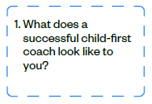
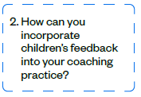
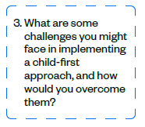
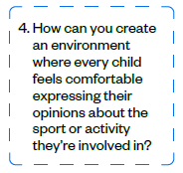
Talking points Discussion cards
Consider/discuss the question(s)
Notes:
Activity: Talking points discussion cards – using questions on pdf document
#1. Discuss in pairs / small groups – all questions / as many as they want to
#2. In groups discuss one question each – then feedback / share with another group
#3. Reflect individually on question(s) most relevant to you
This pack of cards can be printed and cut out. Each group or pair has a pack of cards. One person chooses a card the other person answers the question.

Slide 41
Scenarios cards
Consider/discuss the scenario(s)
Notes:
Activity: scenarios cards – using questions on pdf document
#1. Discuss in pairs / small groups – all questions / as many as they want to
#2. In groups discuss one question each – then feedback / share with another group
#3. Reflect individually on question(s) most relevant to you
These scenarios are designed to help coaches think about how they would tackle common issues they might encounter in a coaching session in a child-first way. You can print this off and cut out each scenario.

Slide 42
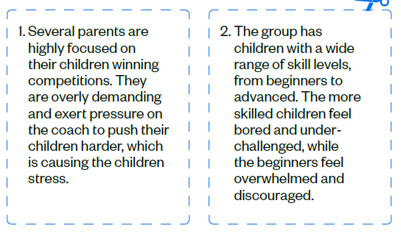
Scenarios cards
Consider/discuss the scenario(s)
Notes:
Activity: Talking points discussion cards – using questions on pdf document
#1. Discuss in pairs / small groups – all questions / as many as they want to
#2. In groups discuss one question each – then feedback / share with another group
#3. Reflect individually on question(s) most relevant to you
This pack of cards can be printed and cut out. Each group or pair has a pack of cards. One person chooses a card the other person answers the question.

Slide 43
Story time
Read the story and reflect on the questions
OR
Write your own story!
Notes:
Activity: story time
*activity on pdf
Good story telling is a powerful tool to help people’s understanding. We’ve created a child-first coaching story and some reflective questions which participants can answer on their own or in groups.
There is also an exercise where the participants can write their own story.
You choose what’s best for your audience.

Slide 44
Reflection Activity
In pairs or in groups reflect on your current practice by asking each other the questions below. Short on time? Select one question from each pillar.
Do you have an agreed way to let the children ‘check in’ at the start of the practice?
How do you create a range of different opportunities for the children and young people at your practice to share their views?
What is the most effective strategy you use to encourage children and young people in practice to share what they think?
Are the participants free to make choices before, during and after the activity?
Which parts of practices would be best for you to give more space to the children to direct their own play?
How much freedom do you give the children and young people to direct their own activity on their own, with a peer, or in the group?
Do you check in with each child to find out what they want from the sessions?
Do you support all personal development goals from confidence building to skills improvement?
If a child changes their mind and wants to pursue a different goal, how do you react?

Slide 45
Child-first Champion Community
Ready to join the movement?

Slide 46



Ways you can get involved and find out more…
Register to keep up to date with the latest news and content
Connect with other coaches at monthly coach catch-ups
Find your local coaching groups and share the Play Their Way message
Create and lead a group in your area, bringing together like-minded coaches
Share your support to the Play Their Way movement on your social channels
Share your child-first coaching story
Facilitate discussions within your own club to embed child-first coaching principles
To find out more visit
Play Their Way

Slide 47
1. How will you keep the child-first coaching conversation going?
Who with?
2. What do you want to find out more about?
How will you do this?
3. What will you try out in your coaching?
When?
Notes:
Activity: Warm up – using questions that promote thinking about using peoples’ lived experience to start to frame their thinking
#1. Discuss in pairs / small groups – all questions / as many as they want to
#2. Four groups discuss one question each – then feedback / share with another group
#3. Choose one question you want to discuss (based on group) *Use the following slides*

Slide 48


Make a child-first coaching commitment!
What things will you do to support voice, choice and journey in your coaching practice?
Notes:
Activity: encourage people to commit to an action they can do!
Write it down and set a reminder to reread what you have written in a month’s time.

Slide 49
How well do you know the
Play Their Way movement?
Activity: Rate your knowledge of Play Their Way and child-first coaching
1 2 3 4 5 6 7 8 9 10
Never heard of it!
I know all about it.
Just call me an expert.
Notes:
ACTIVITY: revisit this to see what has changed

